Slide 1
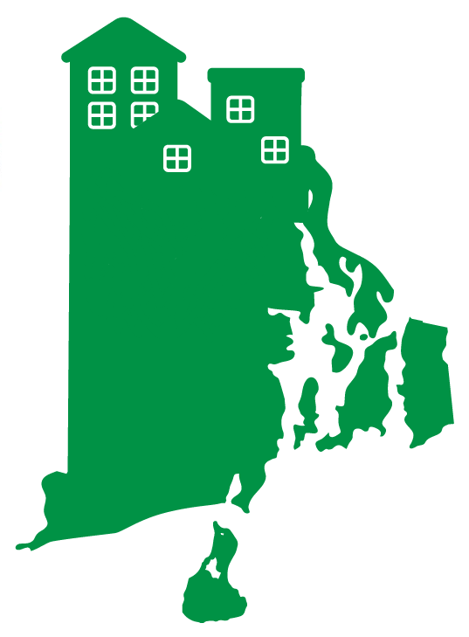
Land Use Strategies for Housing, Climate and Conservation
April 4, 2024

Slide 2
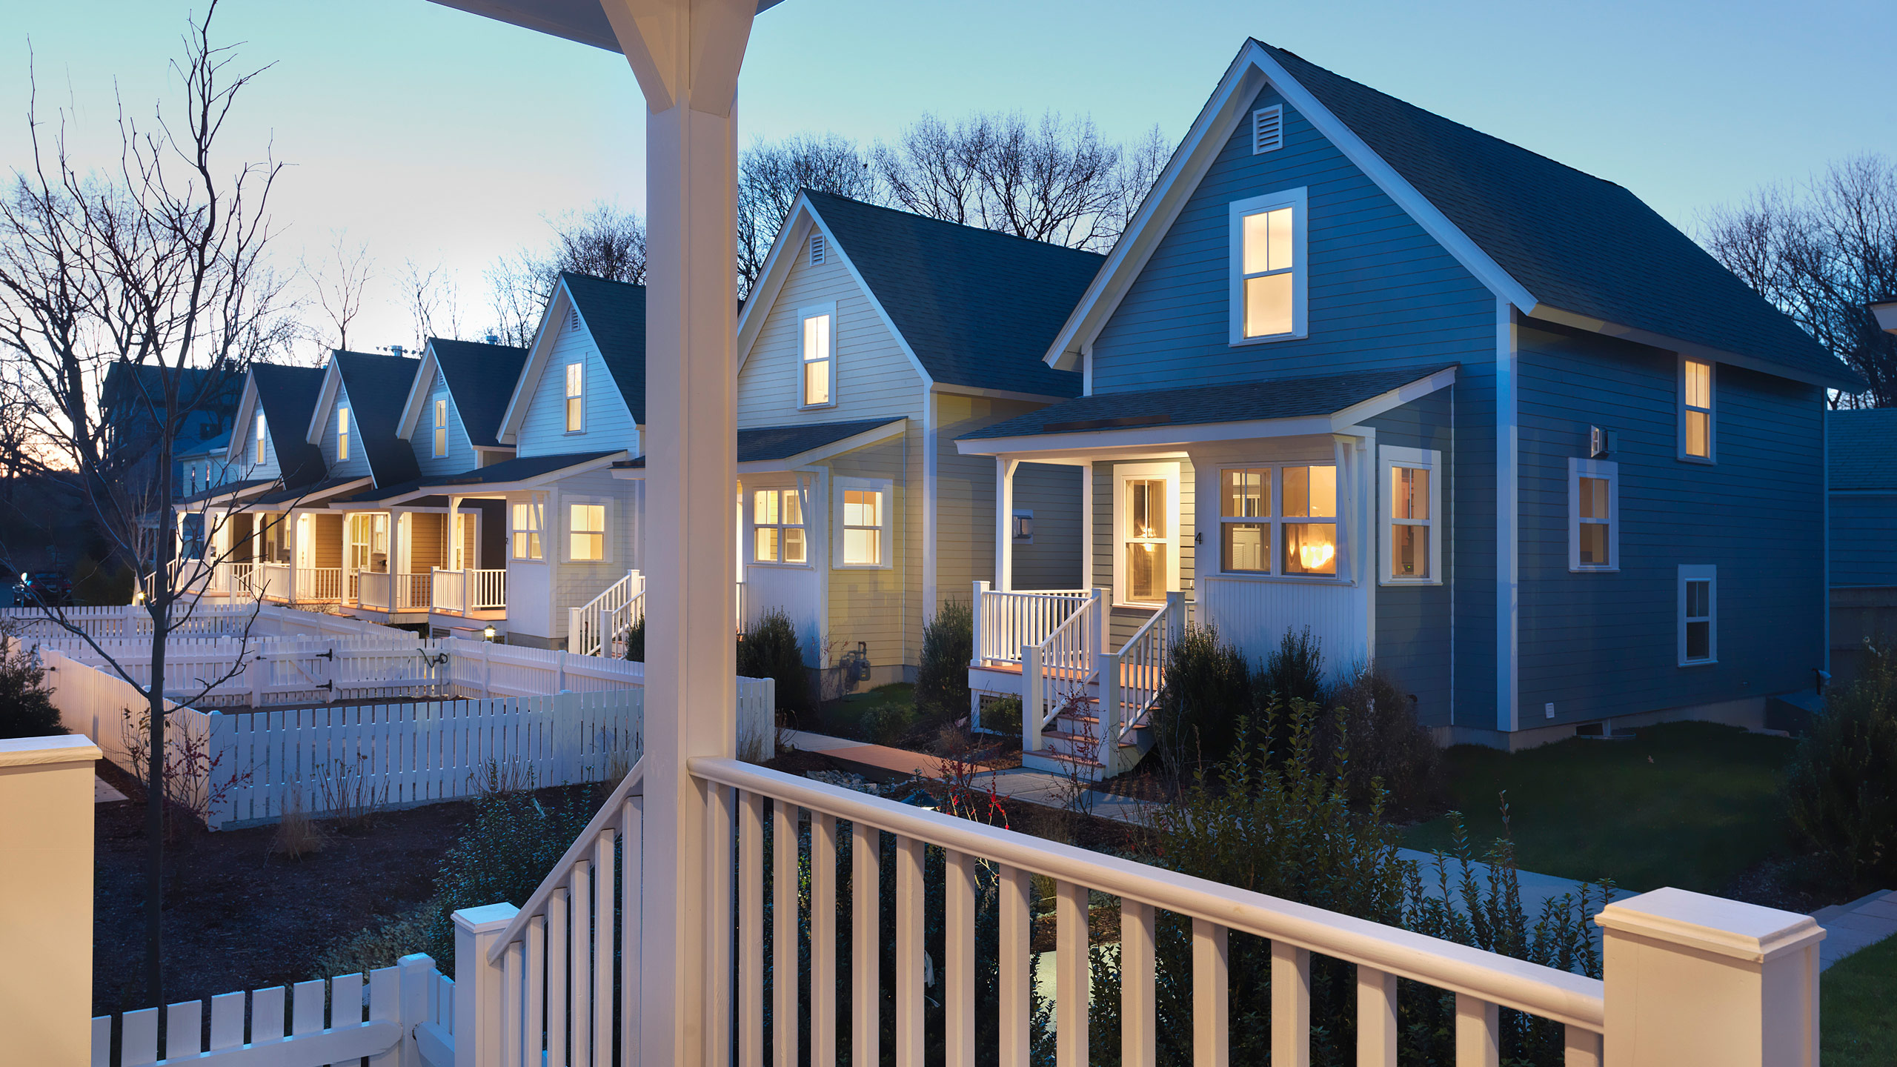
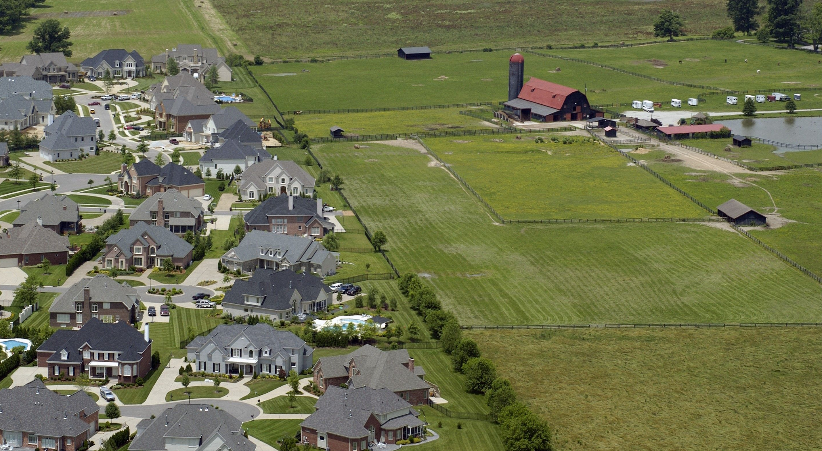
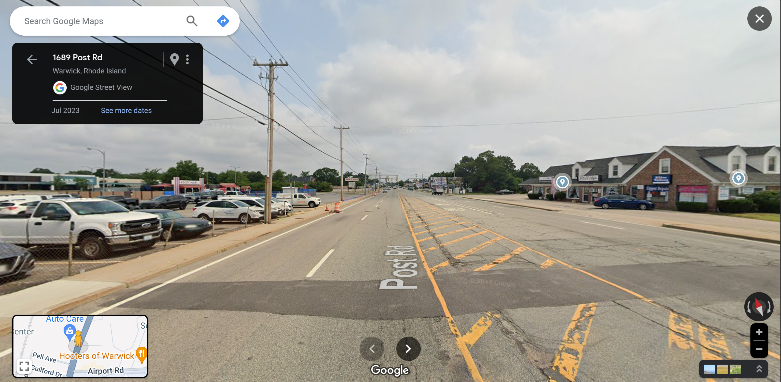

Slide 3
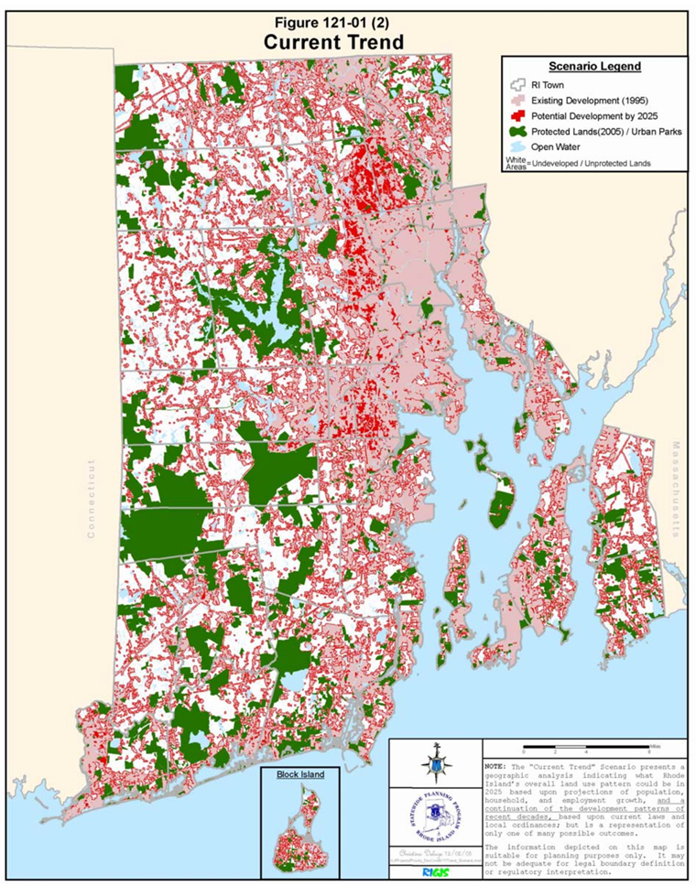
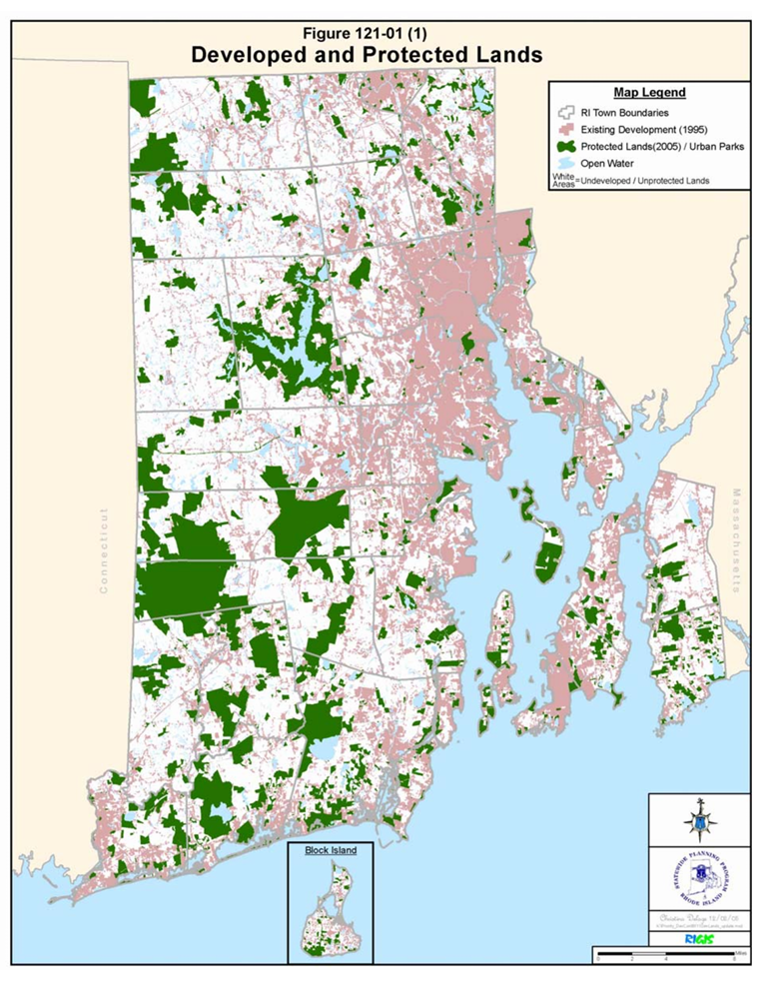
Development trend

Slide 4

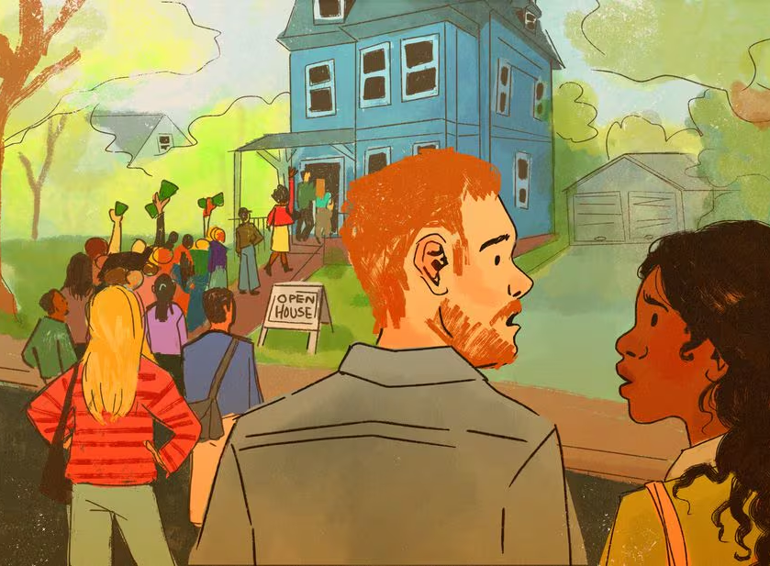

Competing priorities?

Slide 5
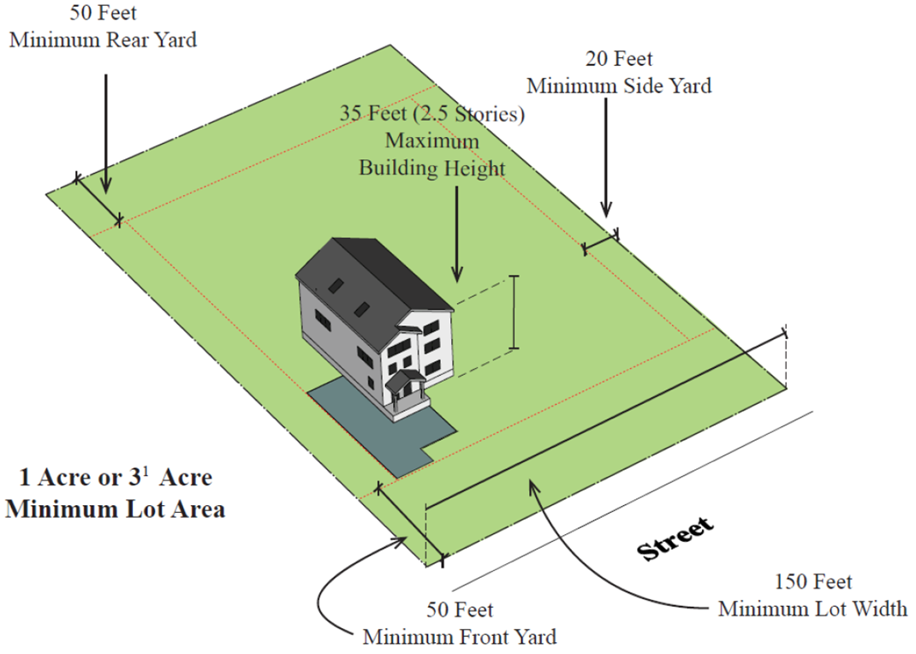

Minimum lot size

Slide 6
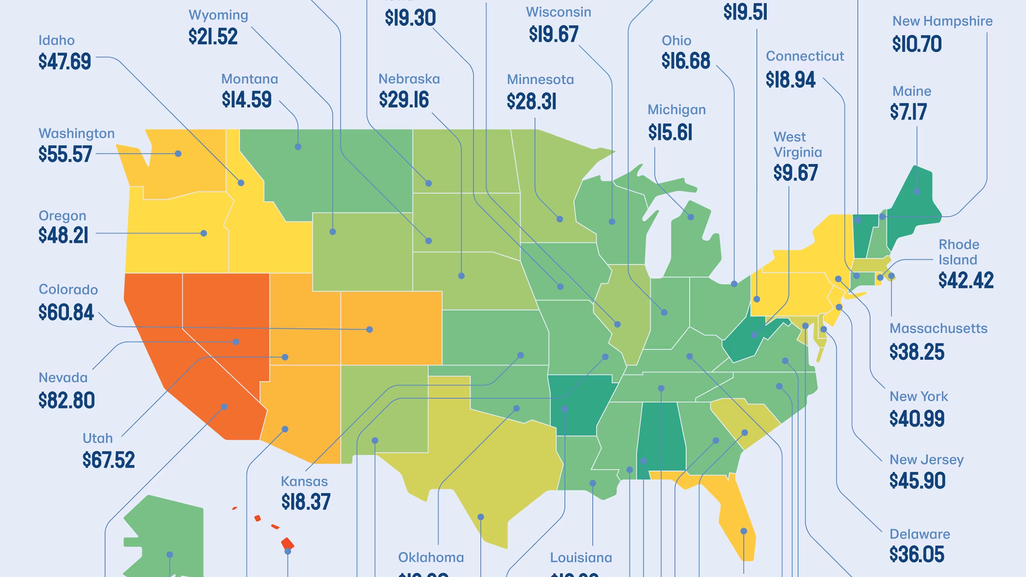
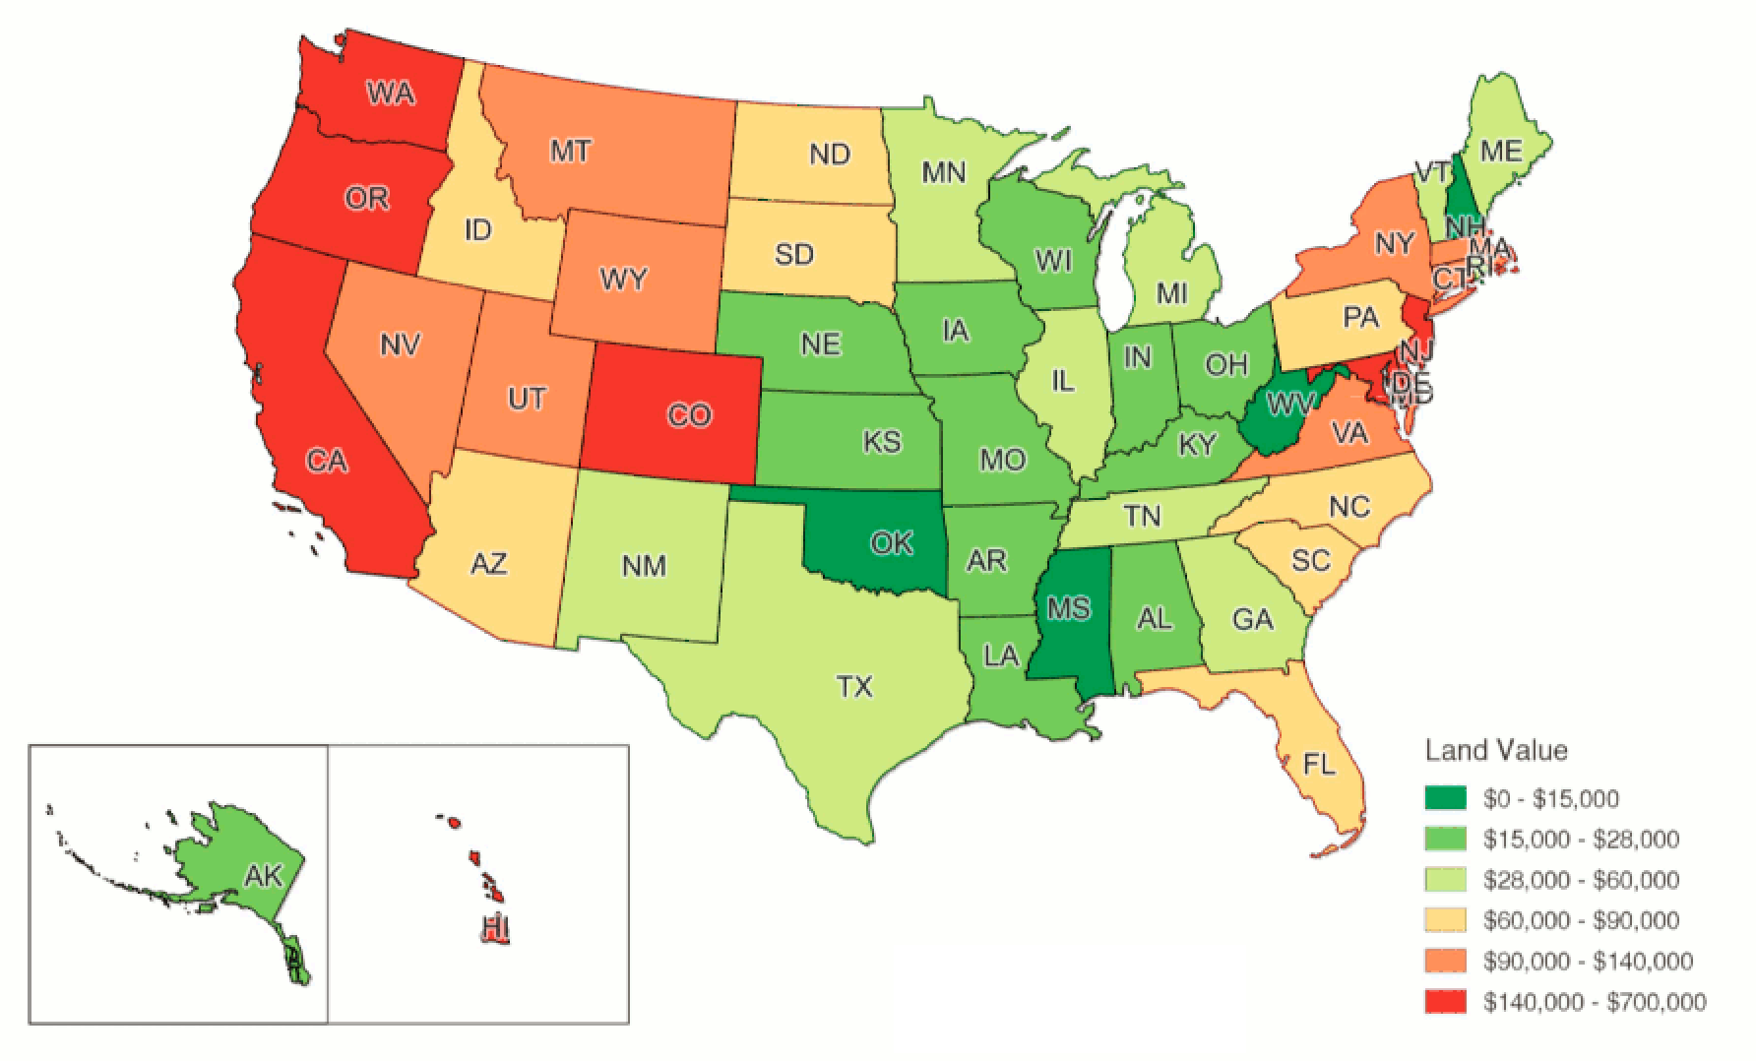
Land = $$$

Slide 7
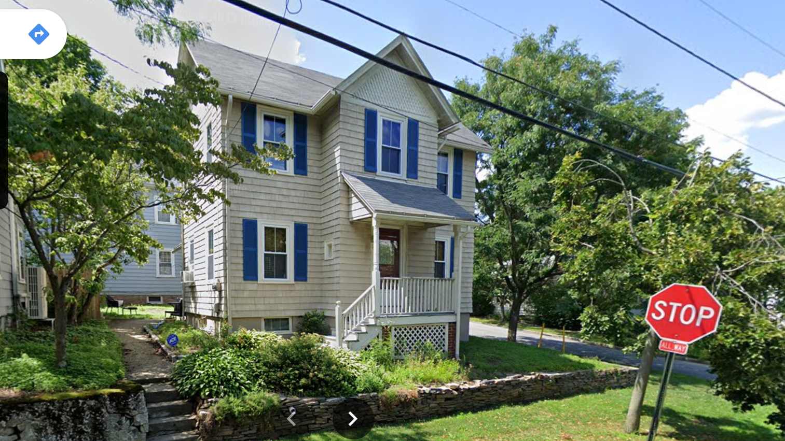

Slide 8
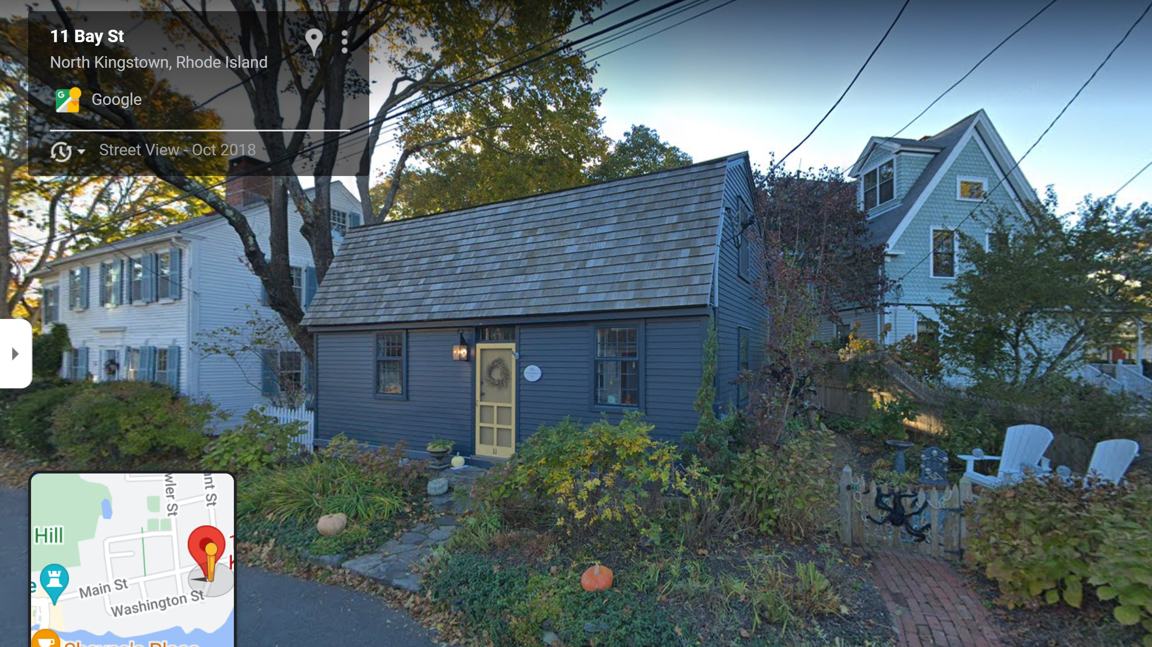

Slide 9
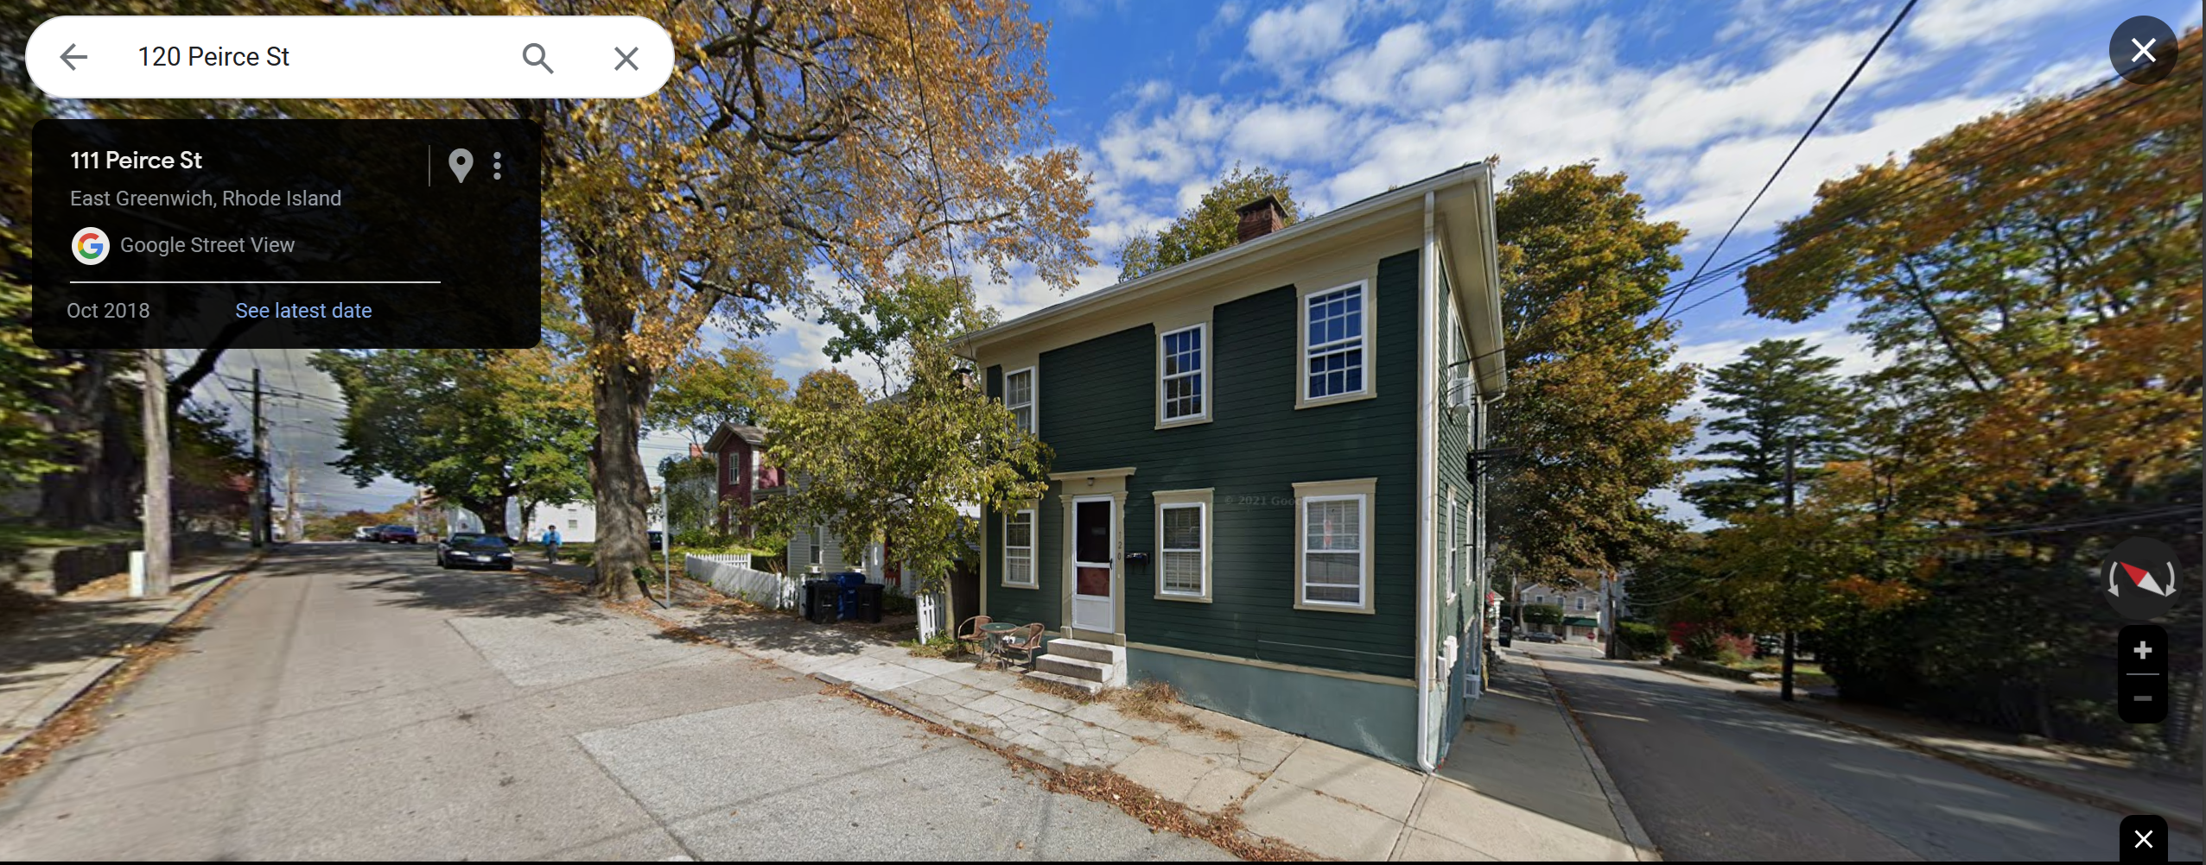

Slide 10
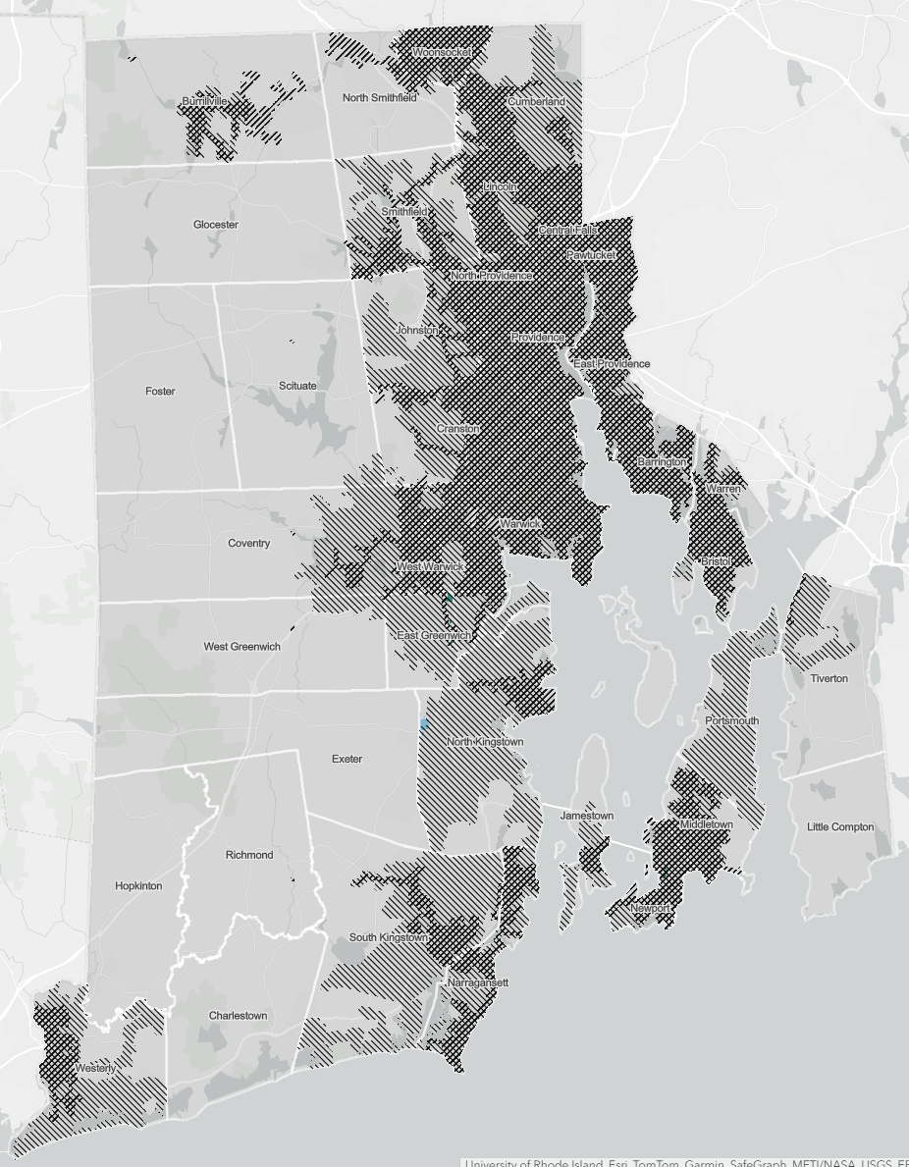
Where can you build a single-family home by right on a new lot of less than 5,000 square feet?

Slide 11
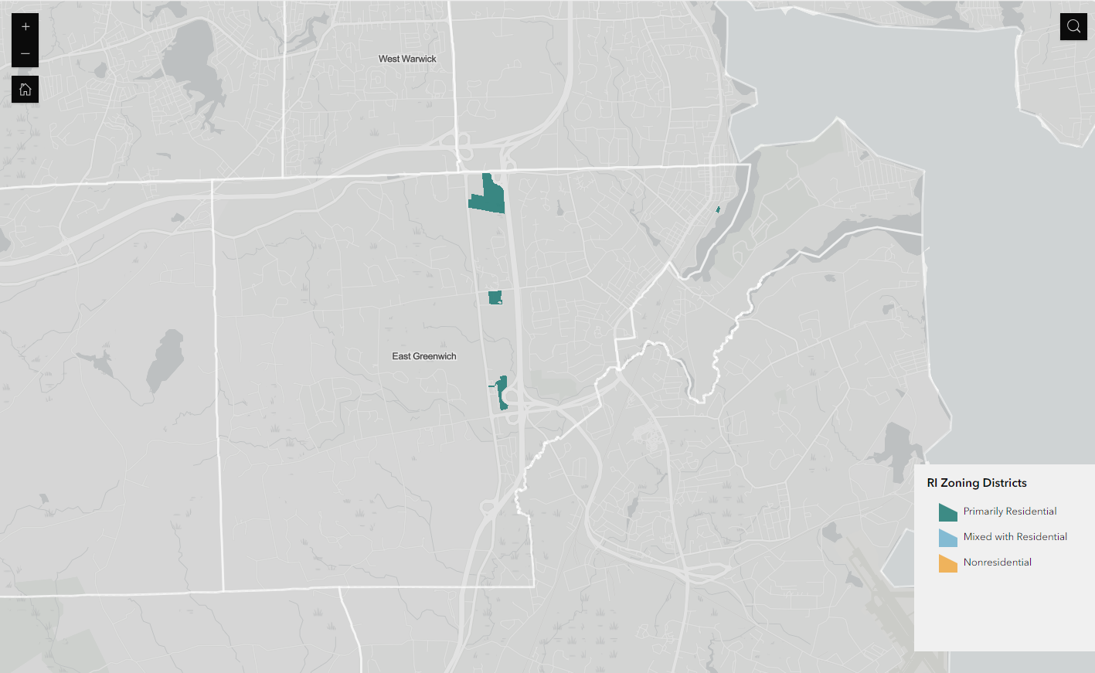
Zoom in slide

Slide 12
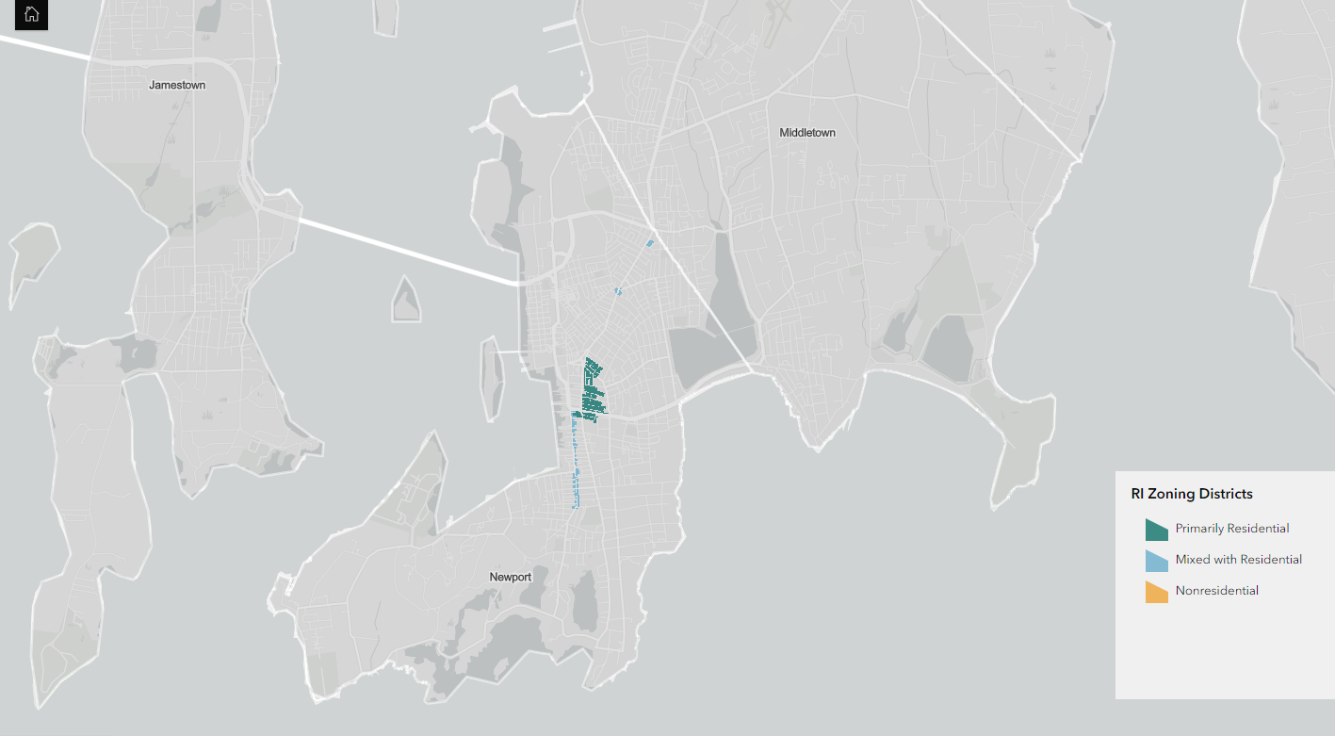
Zoom in slide

Slide 13
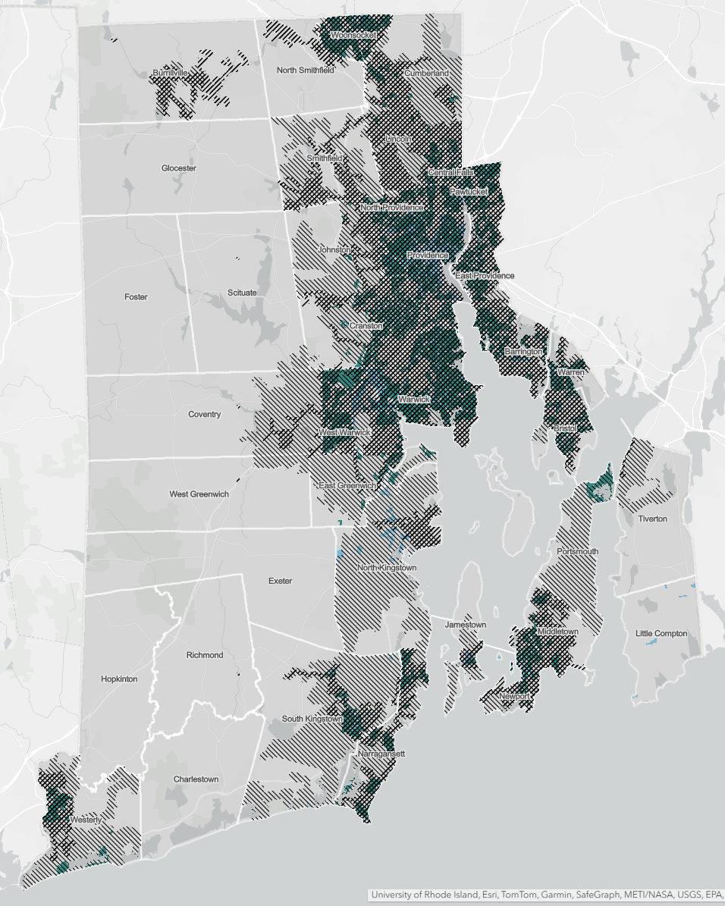
A quarter-acre?
(10,890 square feet)

Slide 14
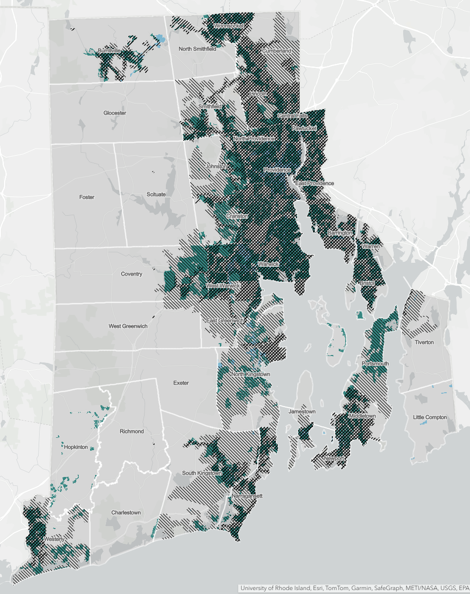
A half-acre?
(21,780 square feet)

Slide 15
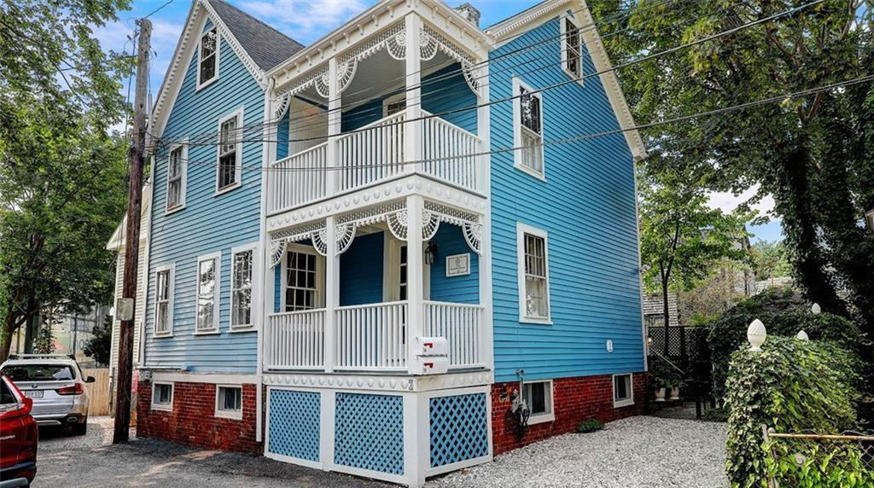
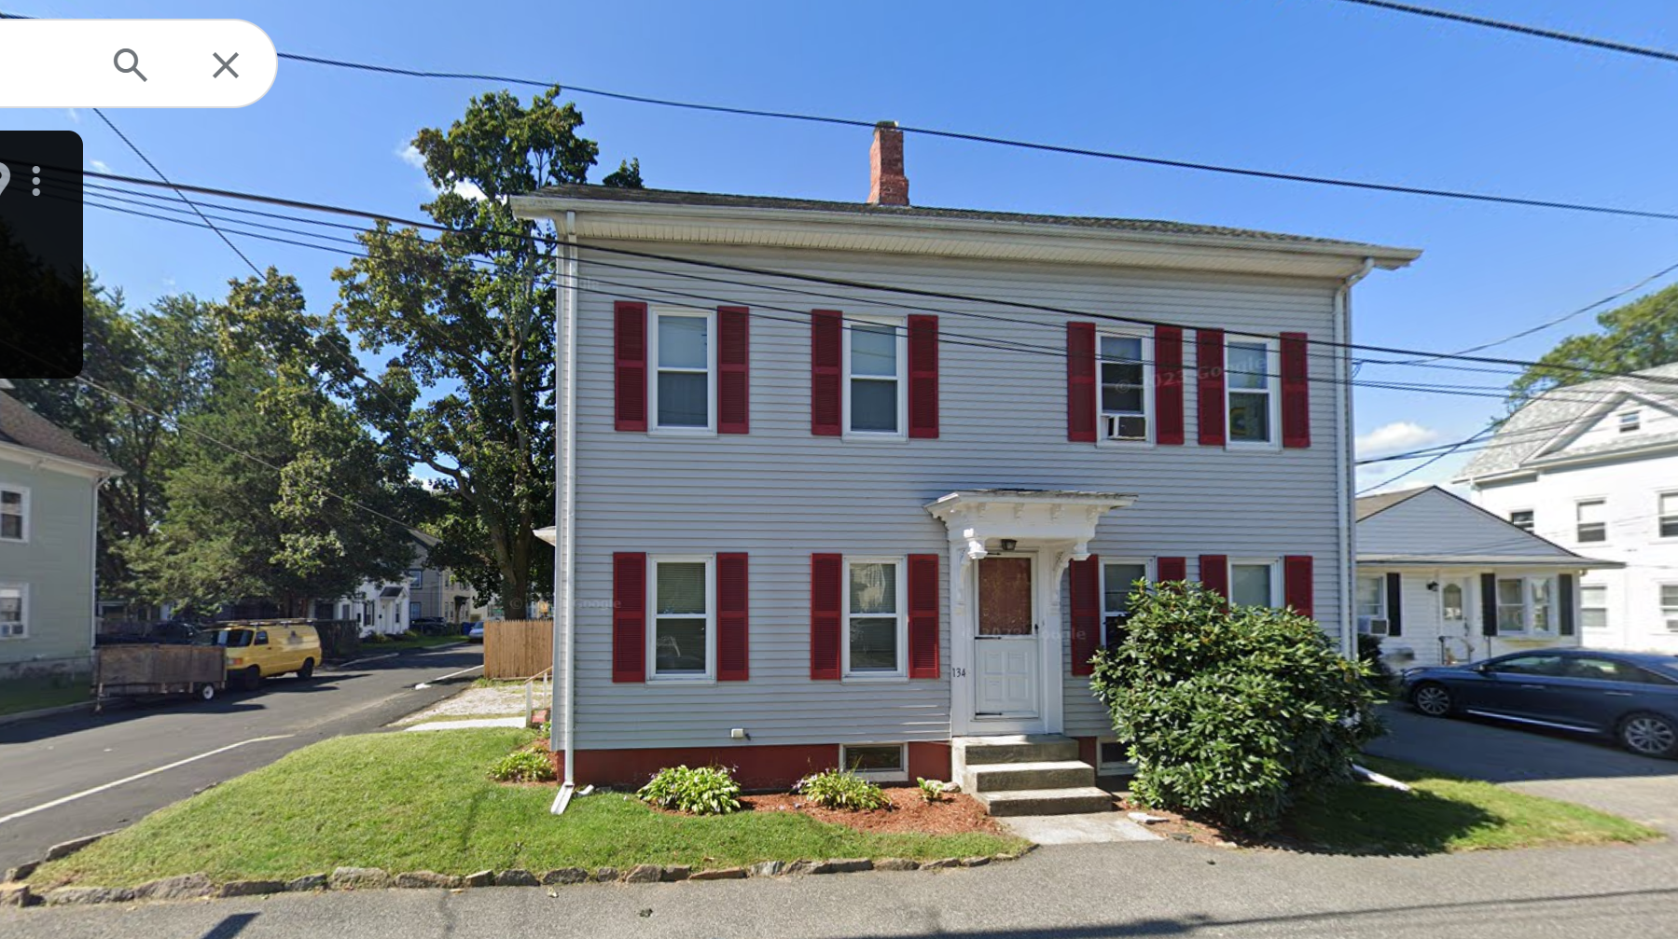

Slide 17
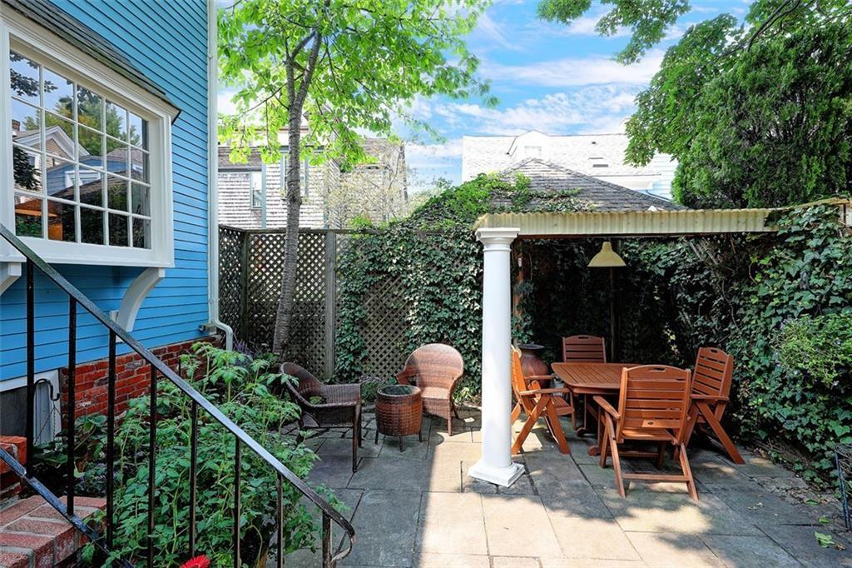

Slide 18
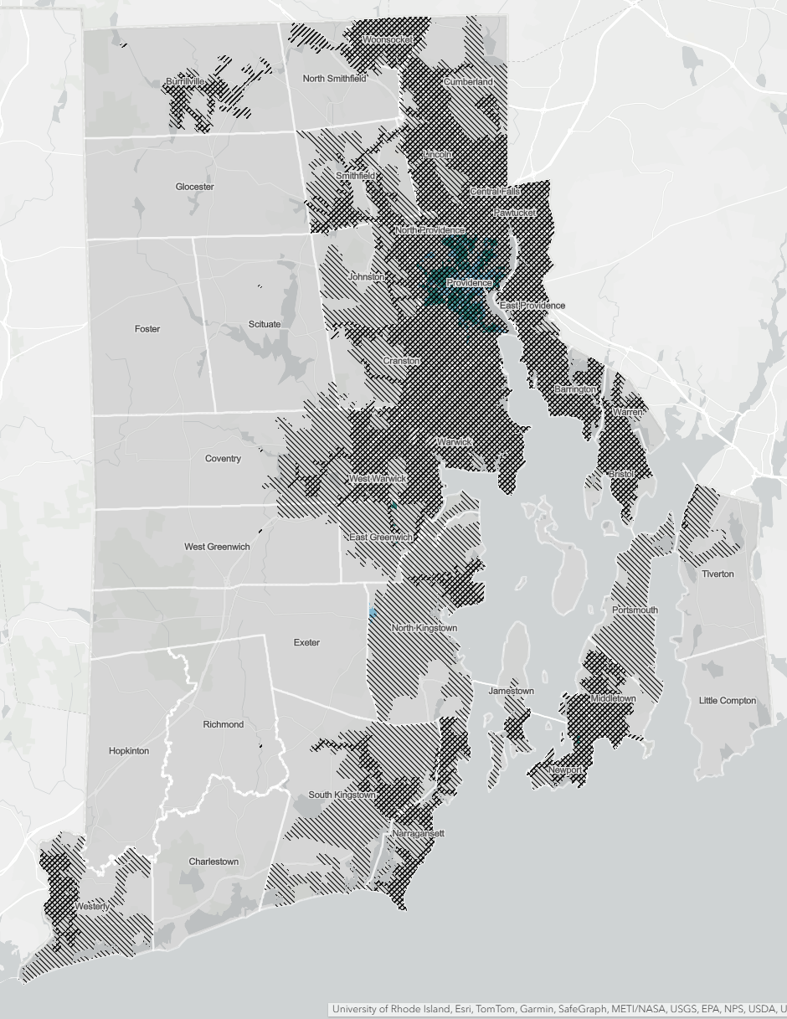
Where can you build a duplex by right on a new lot of less than 5,000 square feet?

Slide 19
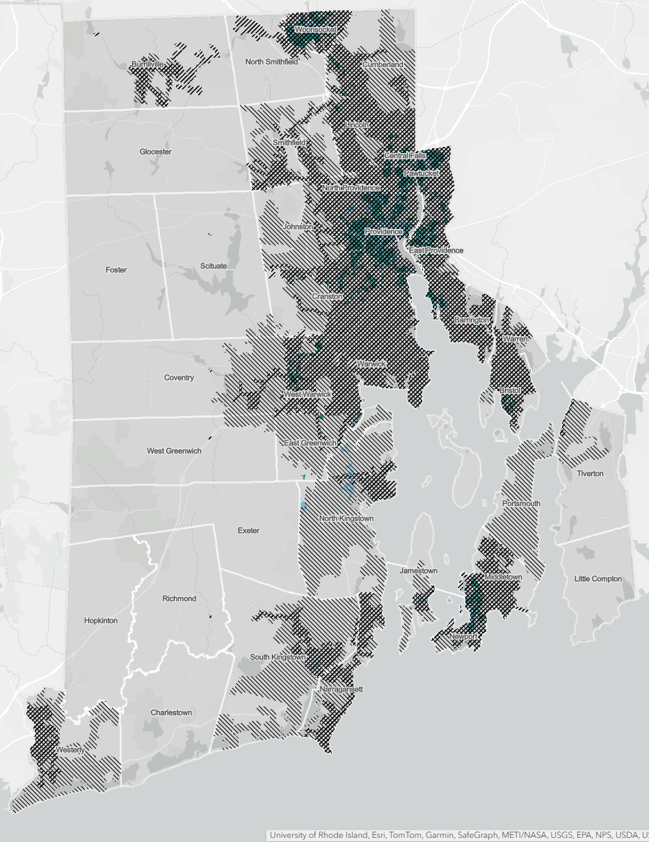
On a quarter-acre?

Slide 20
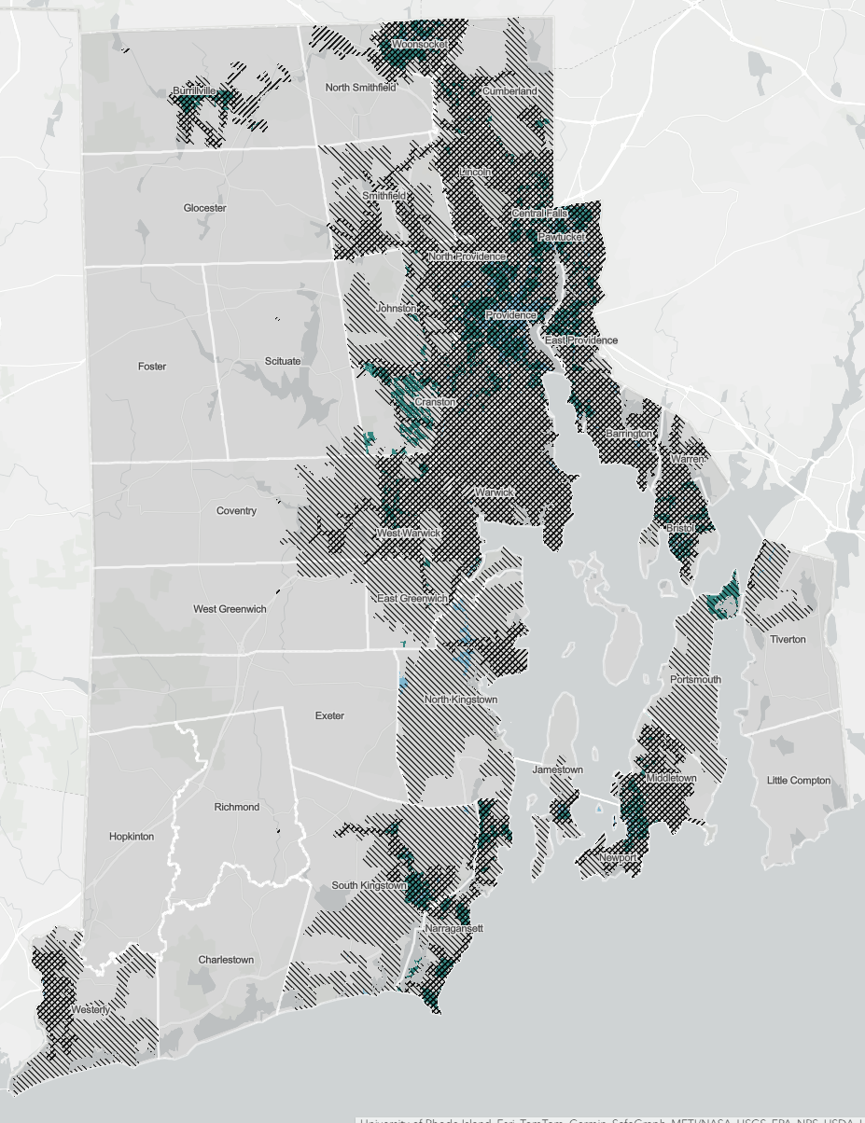
A half-acre?

Slide 21
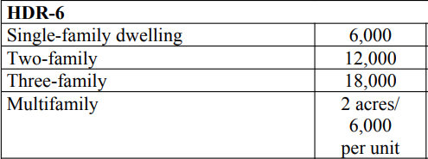
Mandatory sprawl

Slide 22
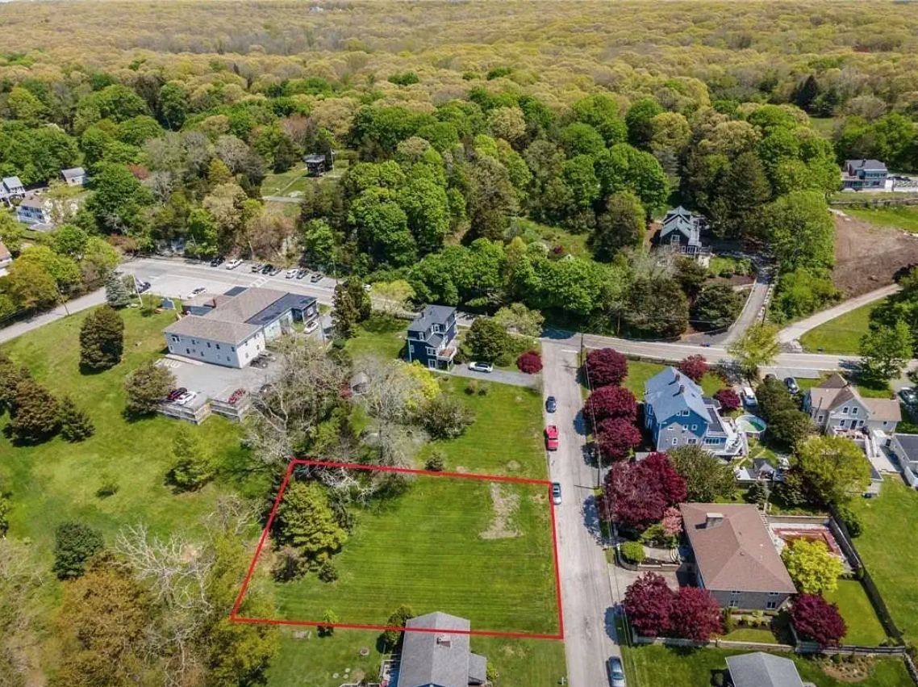
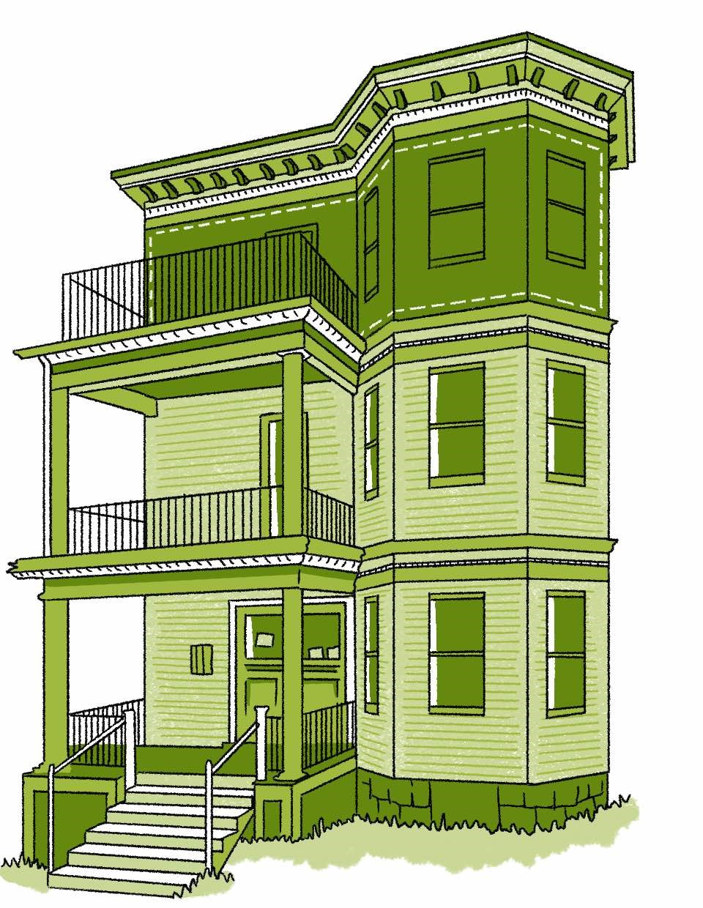

Slide 23
State | Legalizing small-lot homes
Arizona | 4,000 square feet
California | 1,400 square feet
Connecticut | 5,445 square feet
Montana | 2,500 square feet
New York | 1,200 square feet
Texas | 1,400 square feet
Vermont | 5,400 square feet
Washington | 2,000 square feet

Slide 24
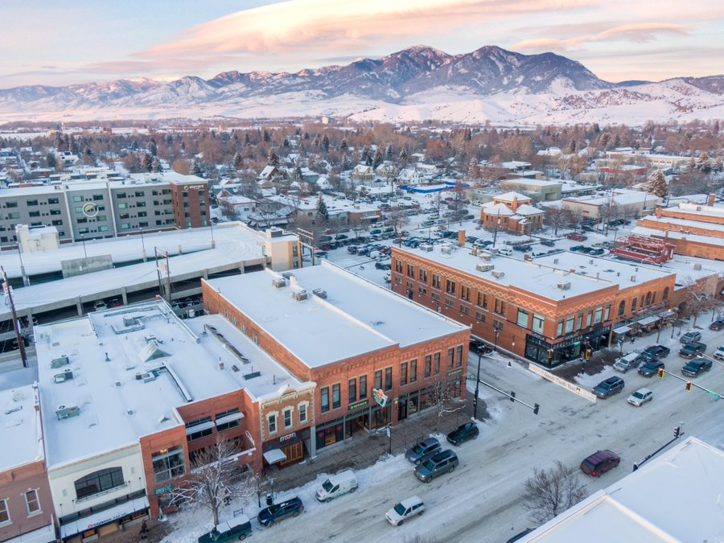
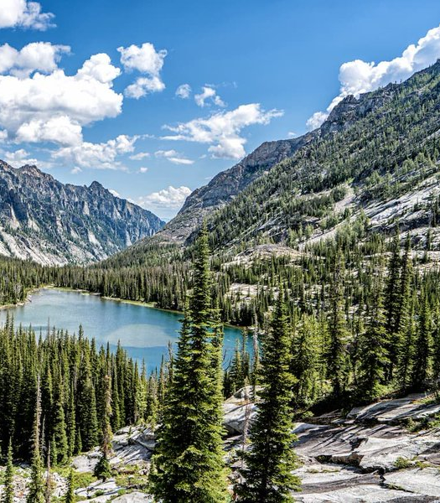
MONTANA CAMPAIGN EXAMPLE

Slide 25
Cities | Legalizing small-lot homes
Austin, TX | 2,500 square feet
Burlington, VT | None
Durham, NC | 2,000 square feet
Gainesville, Fl | 3,000 square feet
Helena, MT | None
Houston, TX | 1,400 square feet

Slide 26
Protecting small multifamily
Washington:
  “[A city or town] shall not require any standards for [duplexes, triplexes, fourplexes, fiveplexes, sixplexes, townhouses, stacked flats, courtyard apartments, and cottage housing] that are more restrictive than those required for detached single-family residences, but may apply any objective development regulations that are required for detached single-family residences.”

Slide 27
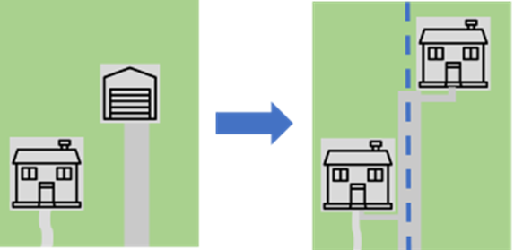
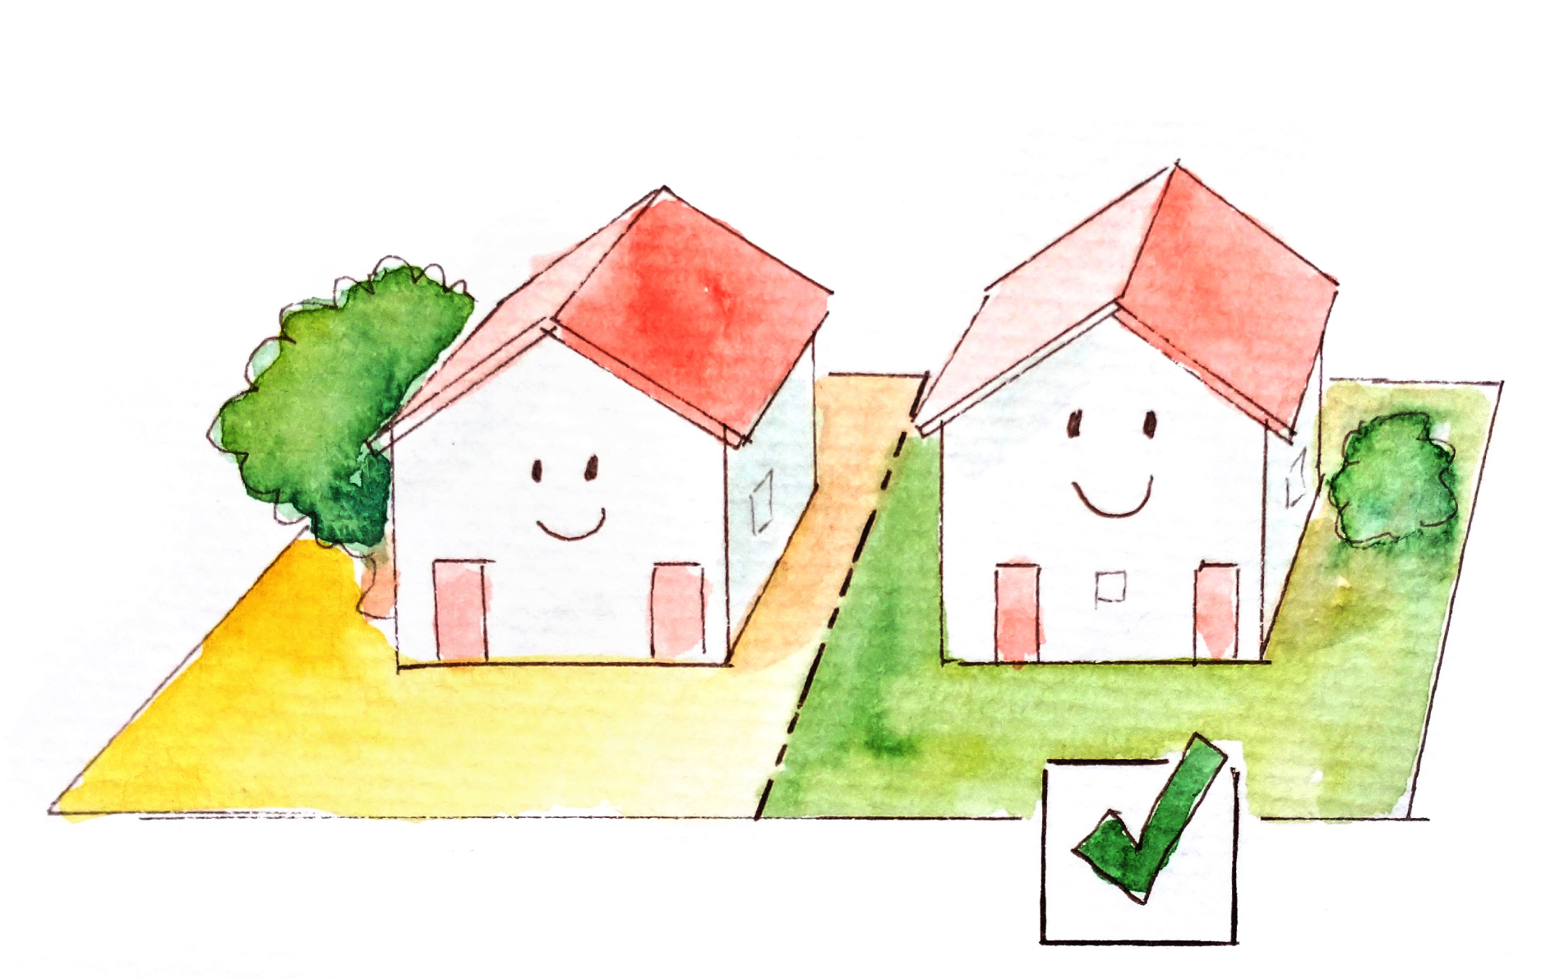
Administrative lot splits

Slide 28
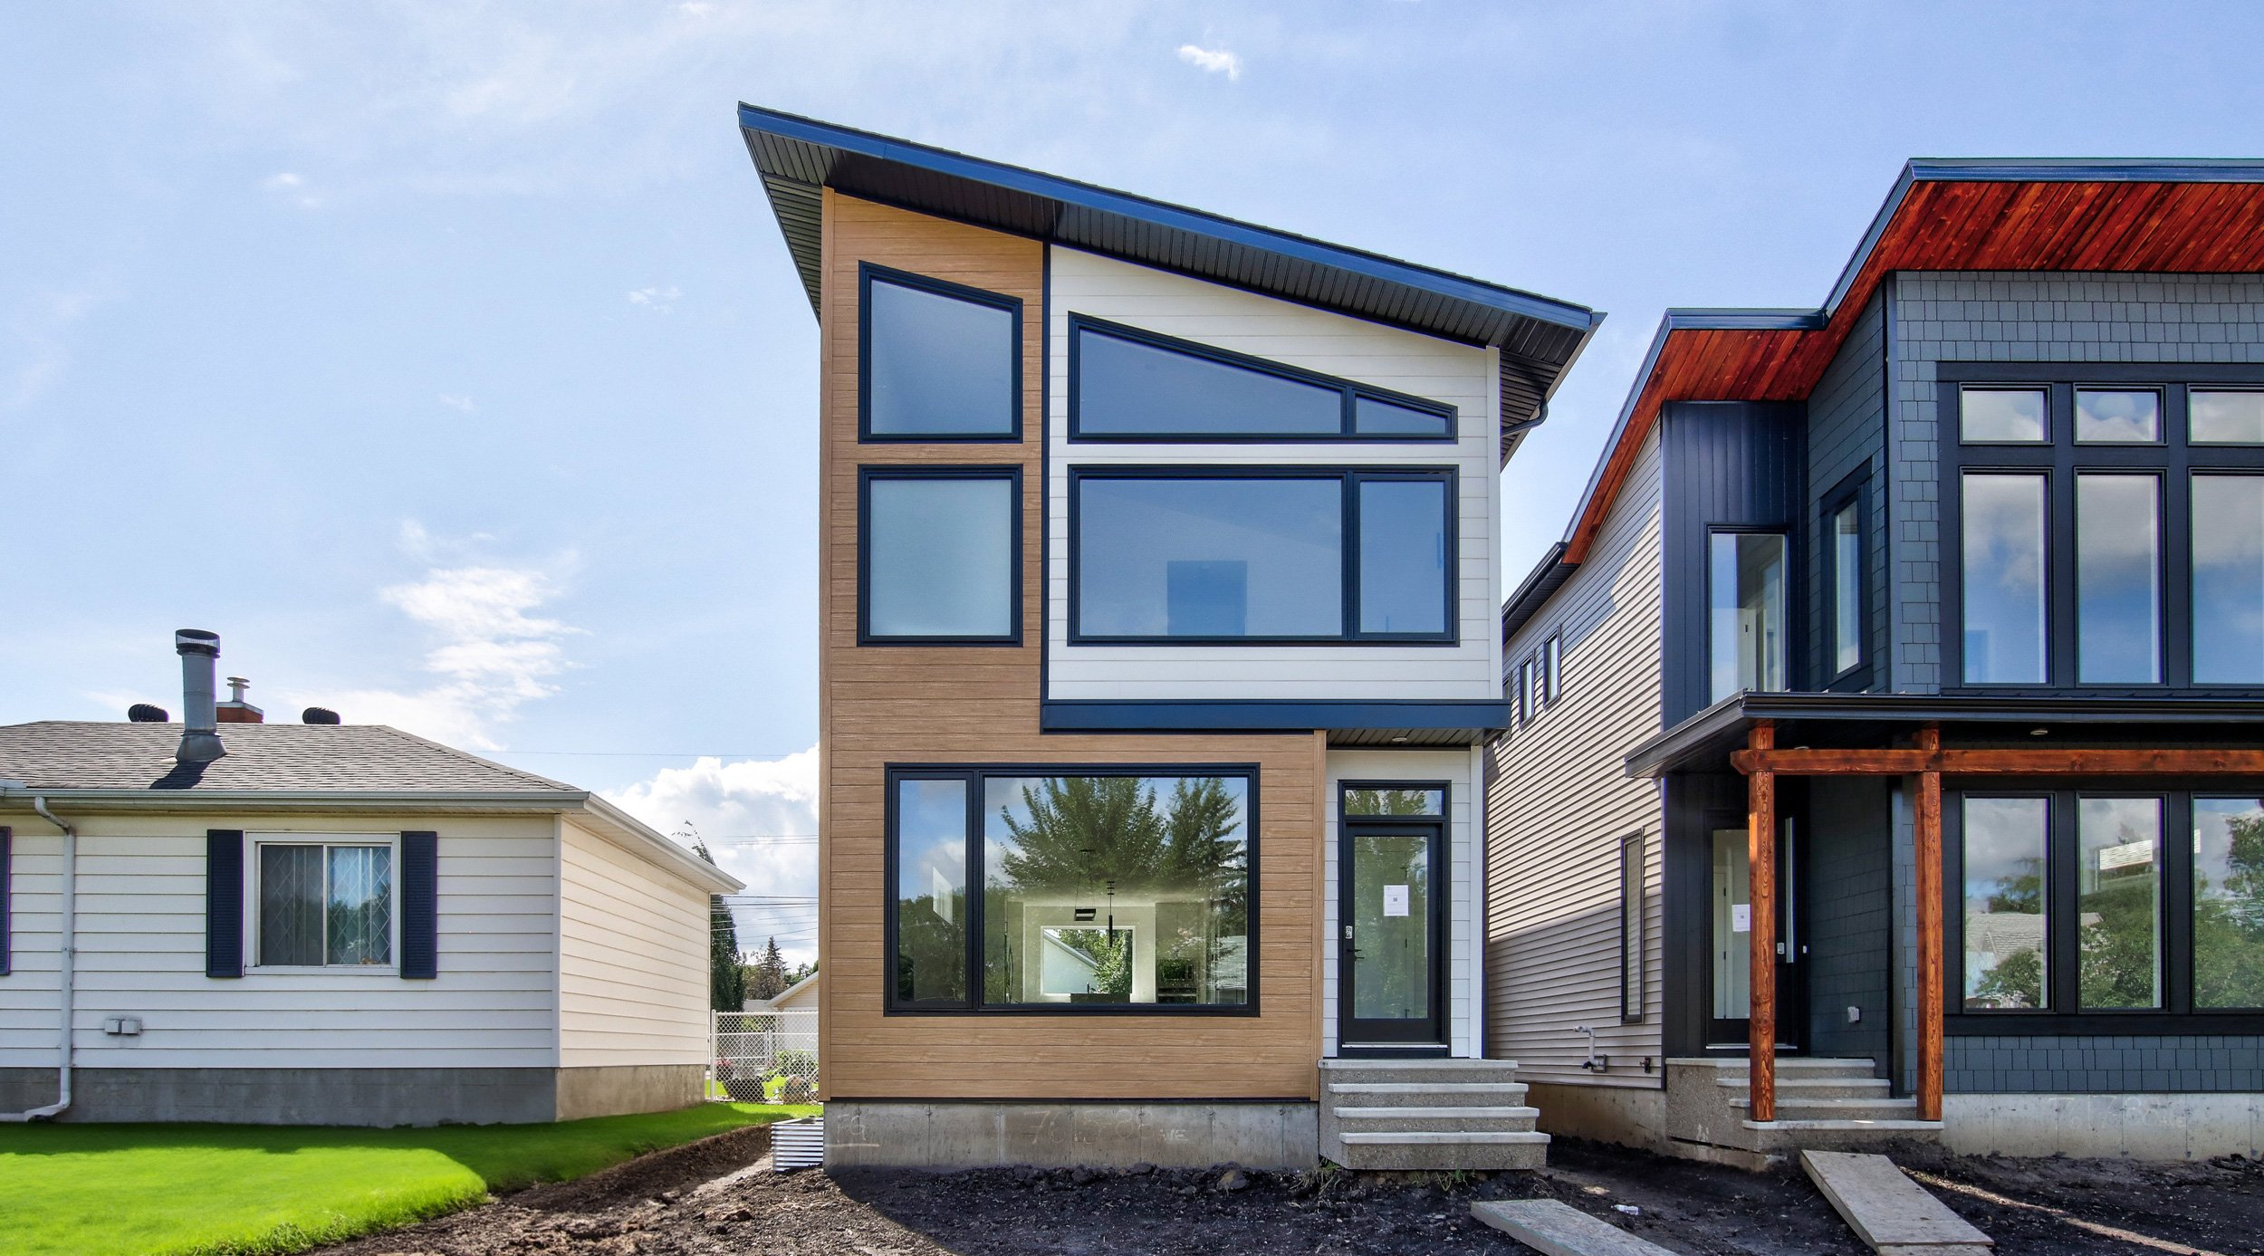
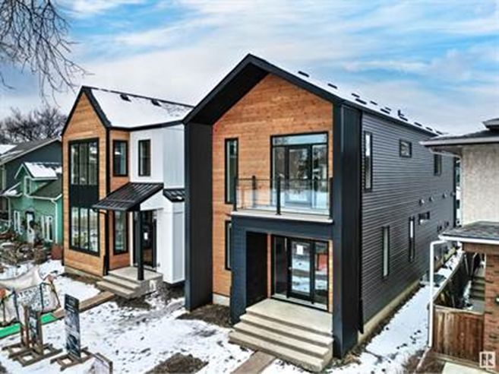
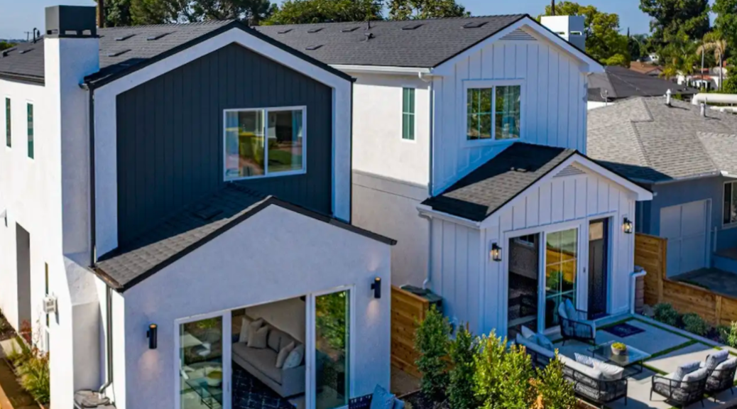
MONTANA CAMPAIGN EXAMPLE

Slide 29
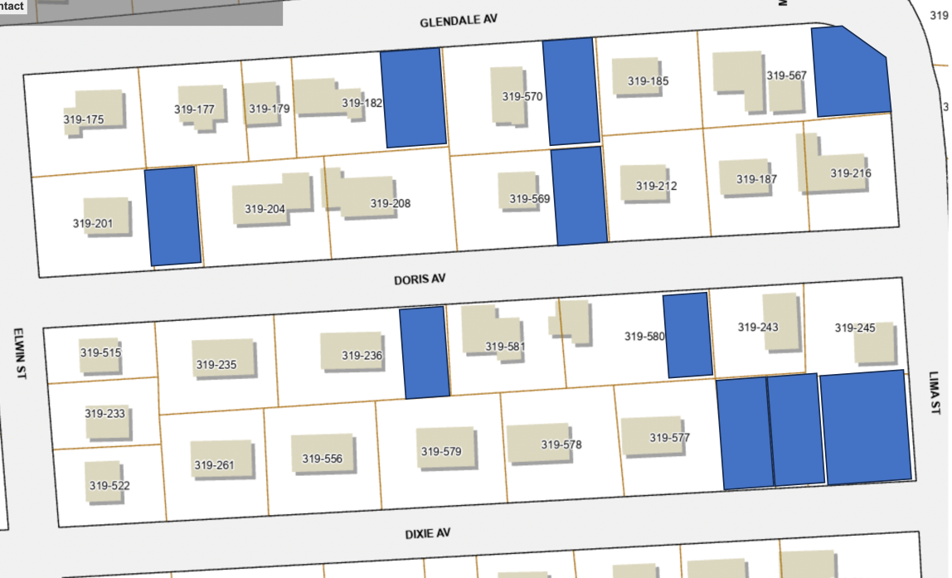
As applied in Rhode Island
36% additional capacity

Slide 30

Thank you.
Find us at:
neighborswelcomeri.org
@rhodyneighbors

